Slide 1
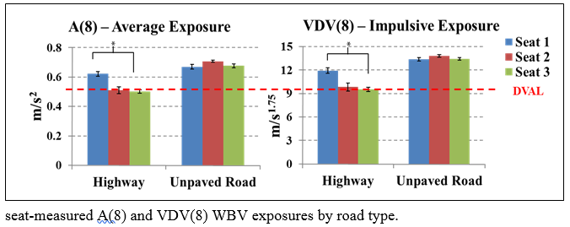
ISRI Outperforms Seat Competition in University of Washington Vibration Testing
National
National
National
National
SEARS
ISRI
SEARS
ISRI
SEARS
ISRI
SEARS
ISRI
18Jan2108

Slide 2
ISRI Outperforms Seat Competition in University of Washington Vibration Testing
The differences in seat performance have important practical implications.
Based on the higher and more restrictive VDV(8) exposures, the higher performing ISRI seats can almost double the amount of time drivers could operate their trucks before reaching the ISO daily vibration action limits from 4 to 7 hours a day to 9 to 13 hours a day. Seat suspension-based design differences are thought to account for the performance differences. The results indicate that ISRI commercial air-suspension seats can and do reduce truck drivers’ WBV exposures.
These seats may ultimately reduce the potential for some vibration related musculoskeletal disorders among truck drivers.
18Jan2108

